Slide 1
Unit 3
Chapter 5
Lesson 1
Day 1
Pages 126-132; 145-146

Slide 2
Possible Questions
Write one possible question for each of the following words:
Quaker
charter
jail
Share your questions with your partner.

Slide 3
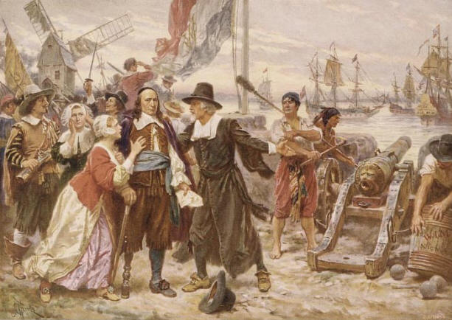
England took control of what is now Pennsylvania in 1664.

Slide 4
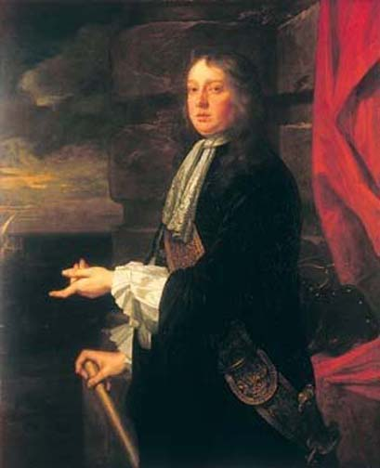
William Penn was born in England on October 14, 1644. His father was a famous admiral in the British navy.

Slide 5
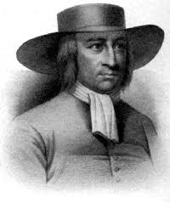
In 1647, George Fox founded the Religious Society of Friends, also known as Quakers.

Slide 6
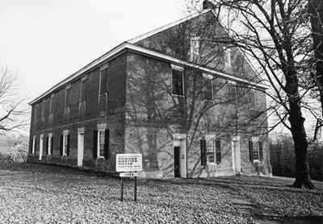
Quakers believed in living simple
lives. They believed in peace and
treating others fairly. They also
thought all people were created equal.
Quaker Meeting House

Slide 7
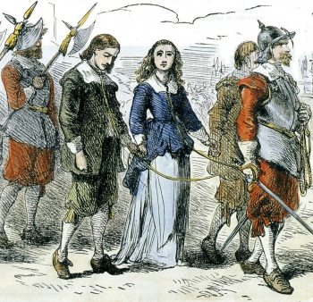
Quakers often got in trouble and went to jail because they didn’t attend the Church of England or take their hats off for the king.

Slide 8
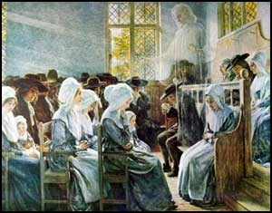
William Penn became a Quaker when he was 23 years old.

Slide 9
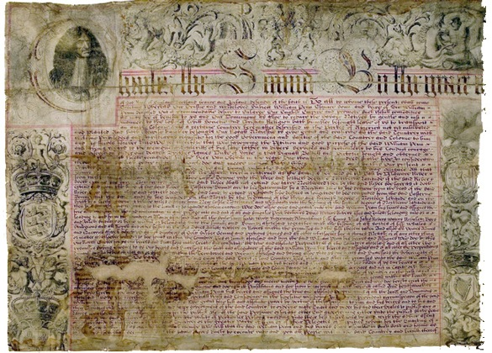
When William Penn’s father died,
King Charles II owed him money.
So to pay off the debt, the king gave William land in America.
This was called the Charter of 1681.

Slide 10
Please Do Now!
Look at the picture on pg. 127 in your text, read the caption, and answer the following question: Do you think William Penn got a good deal? Why or why not? Please write three lines explaining your thinking.
Share what you wrote with your partner.

Slide 11
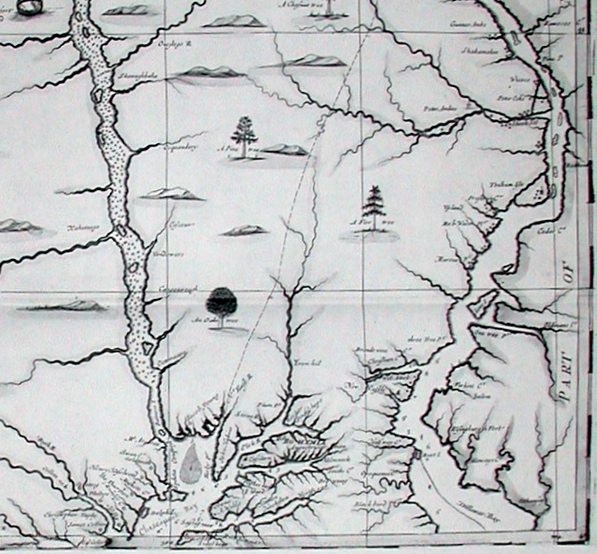
Penn wanted to name the new colony “Sylvania” which means “woods.” The king wanted William to name it after his father.

Slide 12
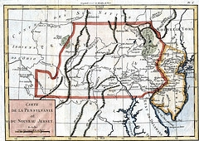
They compromised and called it “Pennsylvania.”

Slide 13
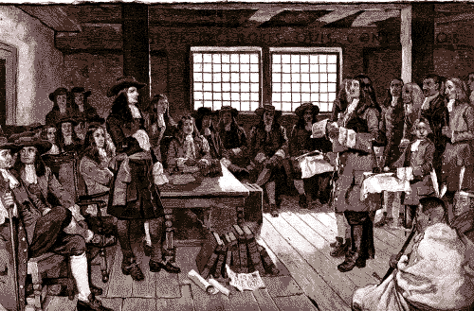
Exit Question
Who are the Quakers and why did they want to come to America?

